Slide 1
CAN Bus
Marcel Breitenfellner, Jürgen Punz | 14. Juni 2017

Slide 2
General
CAN (Controller Area Network)
Automotive Bus System
Connecting ECUs
Producer/Consumer System (like Publisher/Subscriber)
Standardized since 1994 (ISO11898)
Two transmission rates
125kbit/s (convenience)
1MBit/s (powertrain, chassis area, time critical)
Reliable protocol in harsh conditions
1.5V – 3.5V level

Slide 3
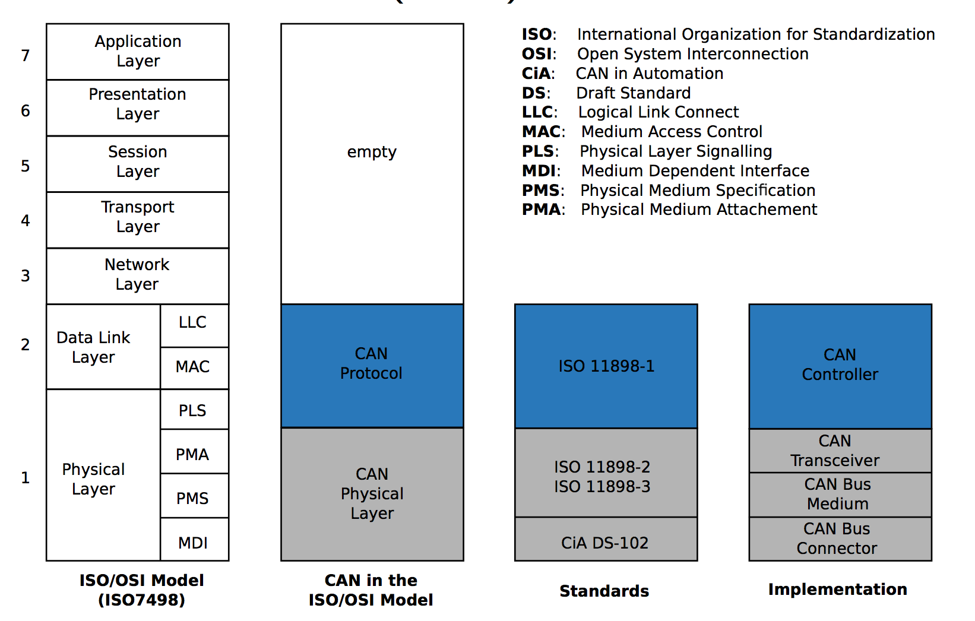
General
OSI Model

Slide 4
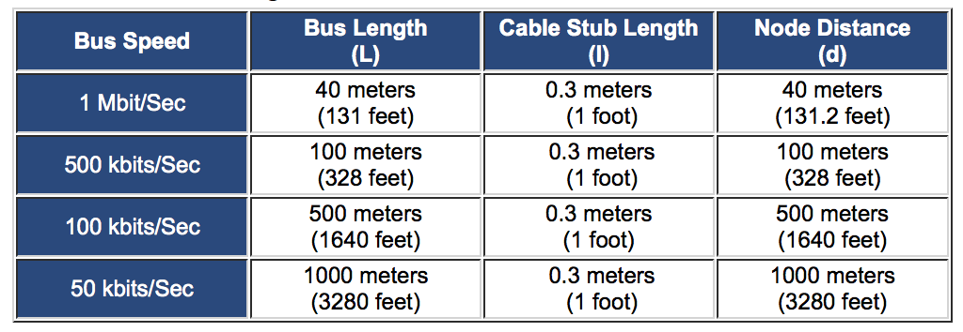
General
Maximum Length

Slide 5
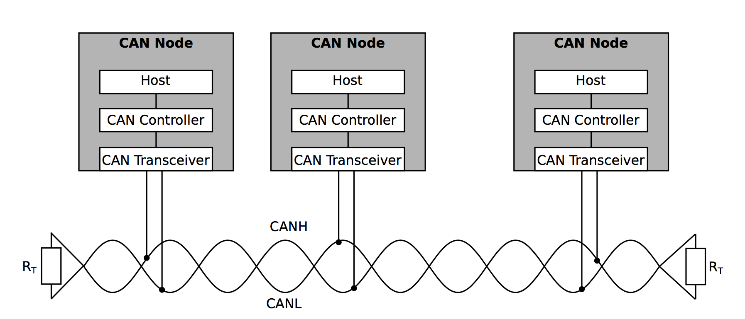
General
Transmission
Transmission hardware for bus access
Software for CAN Protocol
Differential transmission
More robust to interference

Slide 6
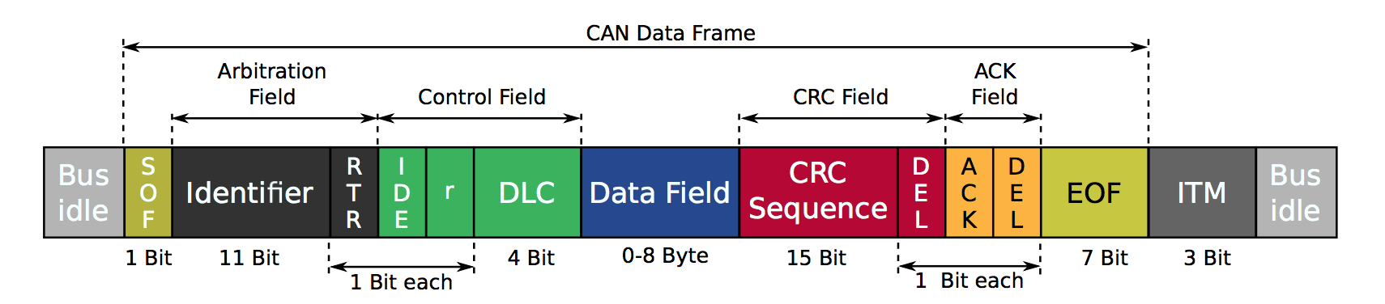
General
Frame
CRC for data protection
Transmission errors can be detected
Receiver ACKs the message (+CRC)
Synchronized through edge transitions
Maximum 130bits in length (fast reaction with 1MBit/s)

Slide 7
General
Communication
Real-time transmission is important
In low milliseconds range
Depends on occurence of special events
130µS per frame
With high bus load the risk of collisions rises
Carrier Sense Multiple Access/Collision Avoidance (CSMA/CA) is used
If collision higher priority wins
Low priority frames could be delayed

Slide 8
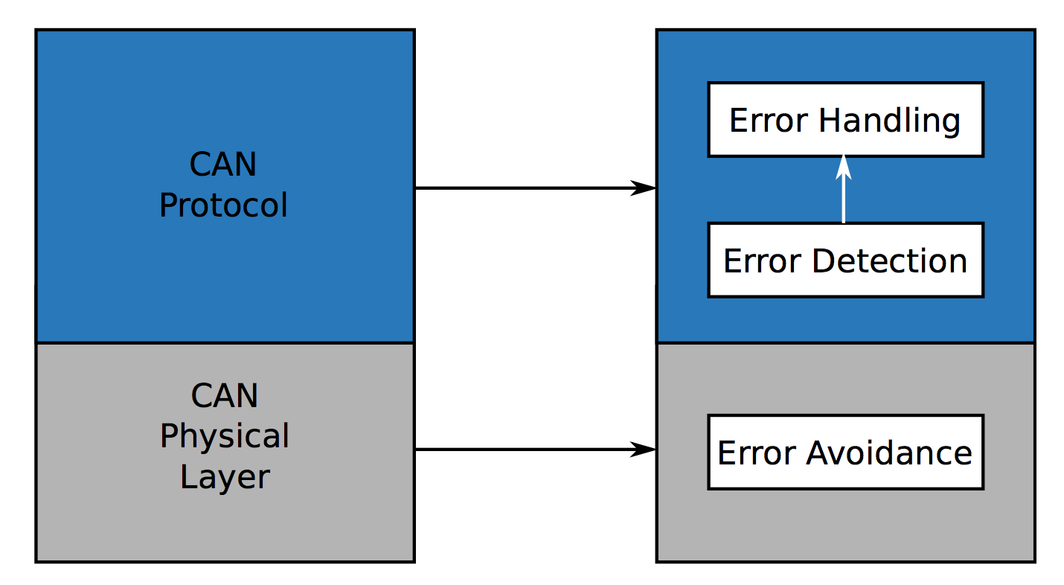
General
Data Protection
CRC over each frame + ACK/NACK
Form check, stuff check
Transmission error on HW level
Error flag
Immediate stop
All transmissions are aborted
As soon as available try again

Slide 9
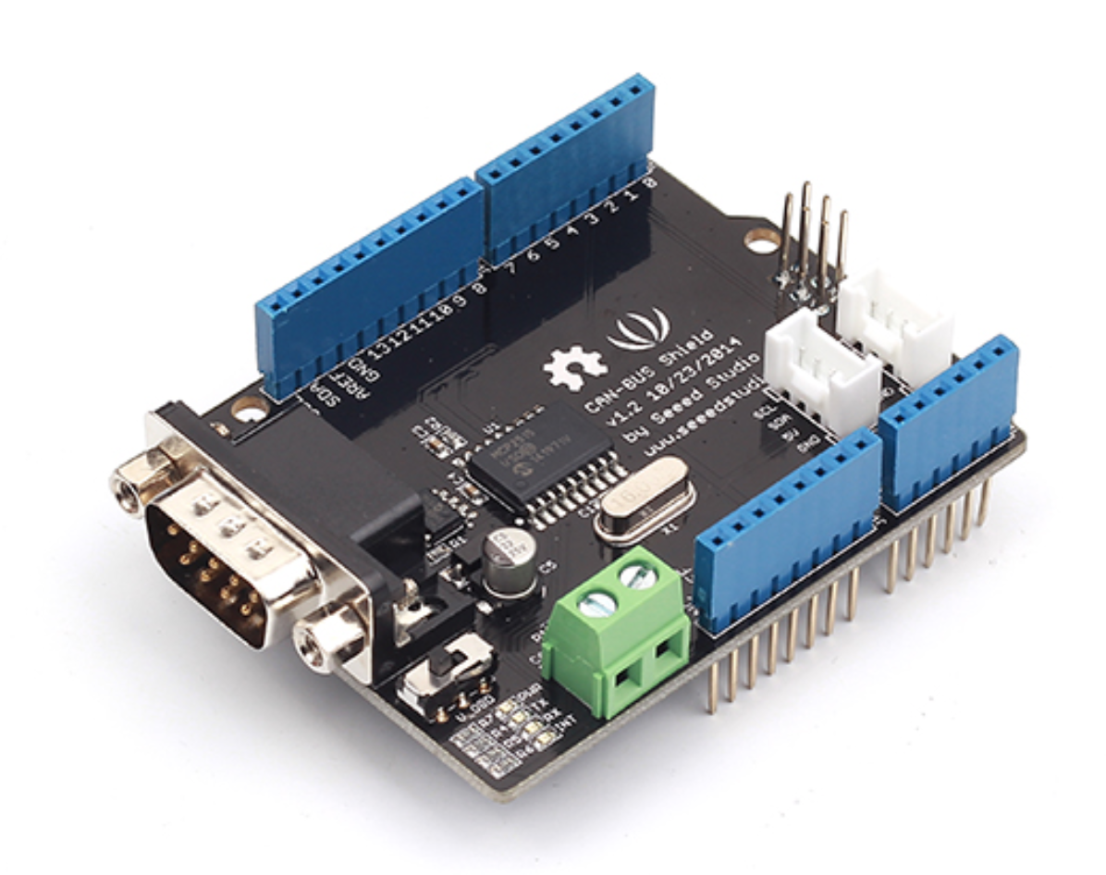
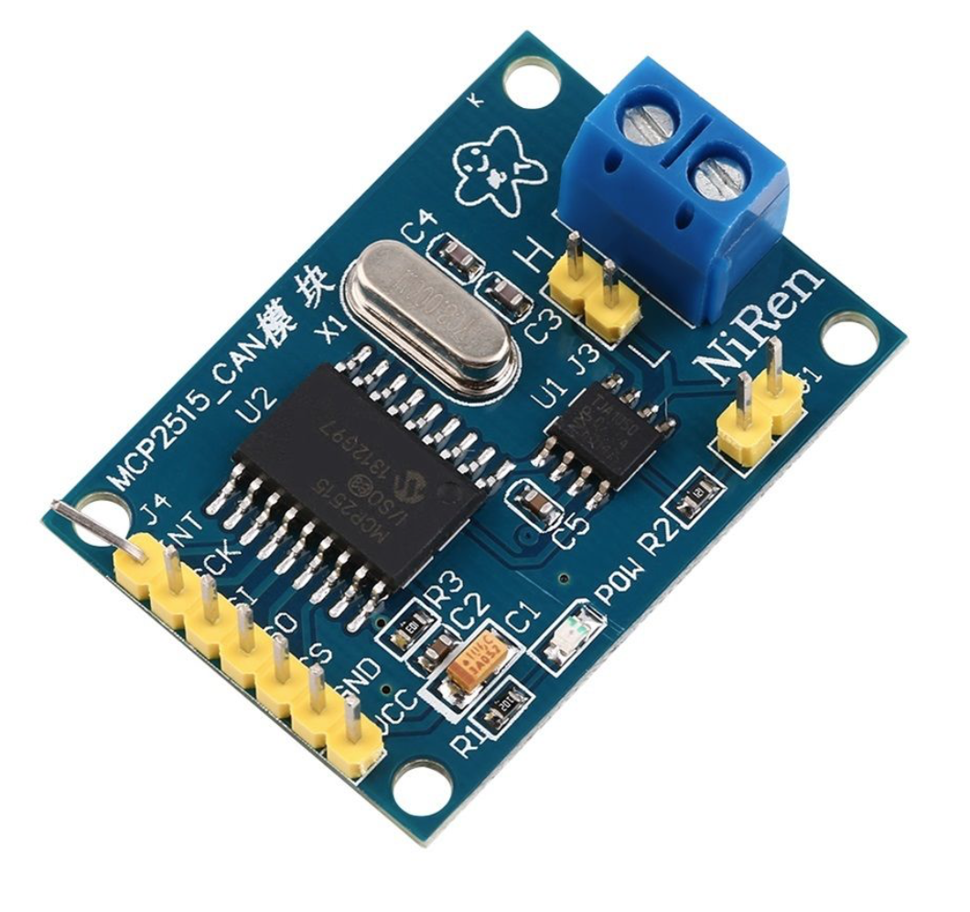

General
Bridge
Arduino Shield available
Starting at 10$ in China
ESP8266 Dev Board
IoT your card
Starting at 10$ in China
OBD2 Bluetooth
~10€ on Amazon

Slide 10
Q&A
http://vector.com/portal/medien/cmc/press/PTR/ SerielleBussysteme Teil2 ElektronikAutomotive 200612 PressArticle DE.pdf
http://vector.com/portal/medien/cmc/press/PressReport-SerielleBussysteme-DE.pdf
https://elearning.vector.com/portal/medien/cmc/press/PTR/ SerialBusSystems Part4 ElektronikAutomotive 200703 PressArticle EN.pdf
https://elearning.vector.com/vl sbs introduction en.html
http://www.digikey.com/en/articles/techzone/2014/jul/
what- engineers- need- to- know- when- selecting- an- automotive- qualified- mcu- for- vehicle- applications

